Slide 1
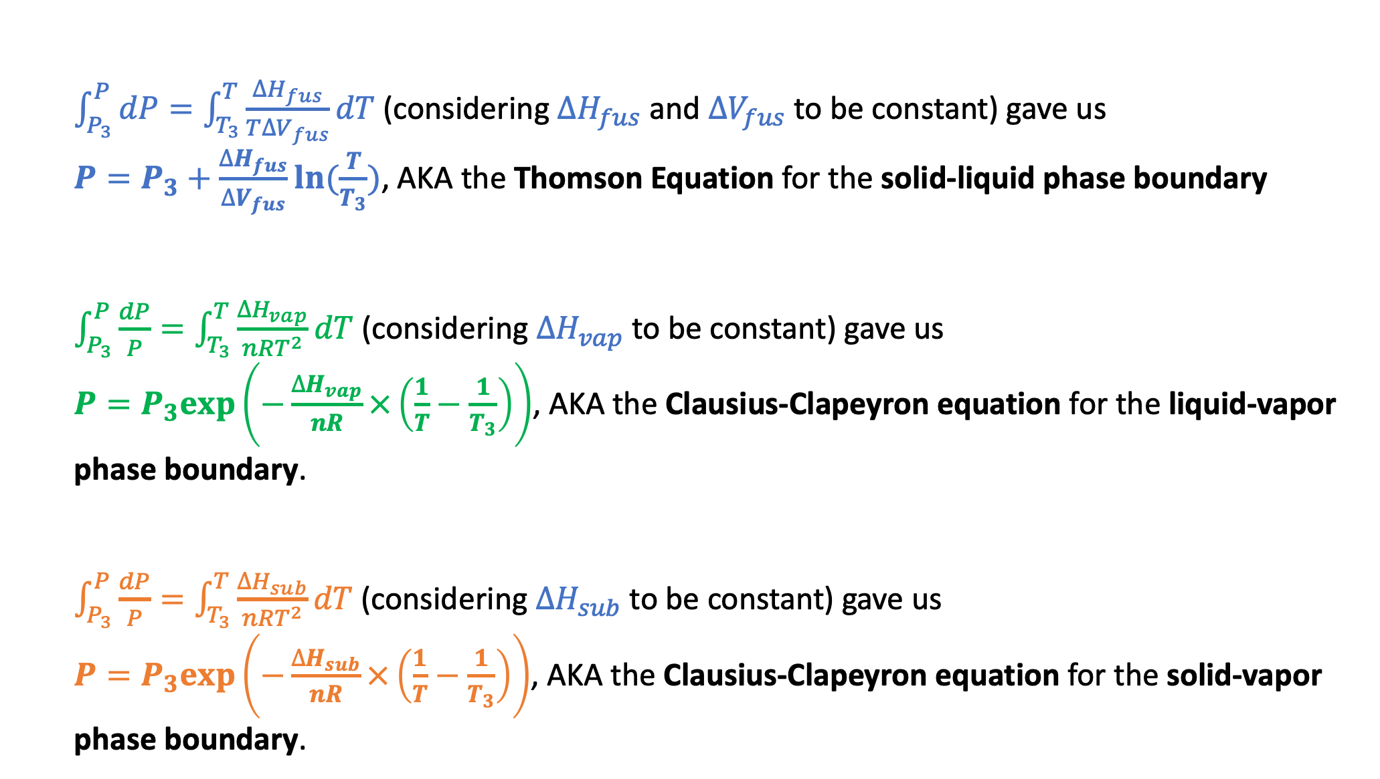
Summary of integrated forms of the Clapeyron Equation
$\int_{P_{3}}^{P}{dP}=\int_{T_{3}}^{T}{\frac{∆H_{fus}}{T∆V_{fus}}dT}$ (considering $∆H_{fus}$ and $∆V_{fus}$ to be constant) gave us
$P=P_{3}+\frac{∆H_{fus}}{∆V_{fus}}ln⁡(\frac{T}{T_{3}})$, AKA the Thomson Equation for the solid-liquid phase boundary
$\int_{P_{3}}^{P}{\frac{dP}{P}}=\int_{T_{3}}^{T}{\frac{∆H_{vap}}{nRT^{2}}dT}$ (considering $∆H_{vap}$ to be constant) gave us
$P=P_{3}exp⁡\left(−\frac{∆H_{vap}}{nR}×\left(\frac{1}{T}−\frac{1}{T_{3}}\right)\right)$, AKA the Clausius-Clapeyron equation for the liquid-vapor phase boundary.
$\int_{P_{3}}^{P}{\frac{dP}{P}}=\int_{T_{3}}^{T}{\frac{∆H_{sub}}{nRT^{2}}dT}$ (considering $∆H_{sub}$ to be constant) gave us
$P=P_{3}exp⁡\left(−\frac{∆H_{sub}}{nR}×\left(\frac{1}{T}−\frac{1}{T_{3}}\right)\right)$, AKA the Clausius-Clapeyron equation for the solid-vapor phase boundary.

